Slide 1

Running Man
Homeowner’s Association Meeting
4 December 2023
Tabb Elementary School Cafeteria
7:00PM

Slide 2
AGENDA
President’s Welcome Eric Todhunter
York County District 5 Representative Comments Tom Shepperd
President’s Report Eric Todhunter
  Status of Governing Document
  Long-Range Funding Assessment Review
  Status of Volunteerism
Webmaster Report Allison Rockwell
Treasurer’s Report Gail Astor
Neighborhood Watch James Wright
Architecture Control Report Jon Waechter
Covenants Report Kyle Aulenbach
Landscape / Common Area Report Chris Lowrey
CY2023 Accomplishments Overview Eric Todhunter
Election of Officers for 2024 Board Eric Todhunter

Slide 3
York County Representative
Tom Shepperd
District 5 Representative
York County Board of Supervisors
shepperd@yorkcounty.gov
(757)903-1875

Slide 4
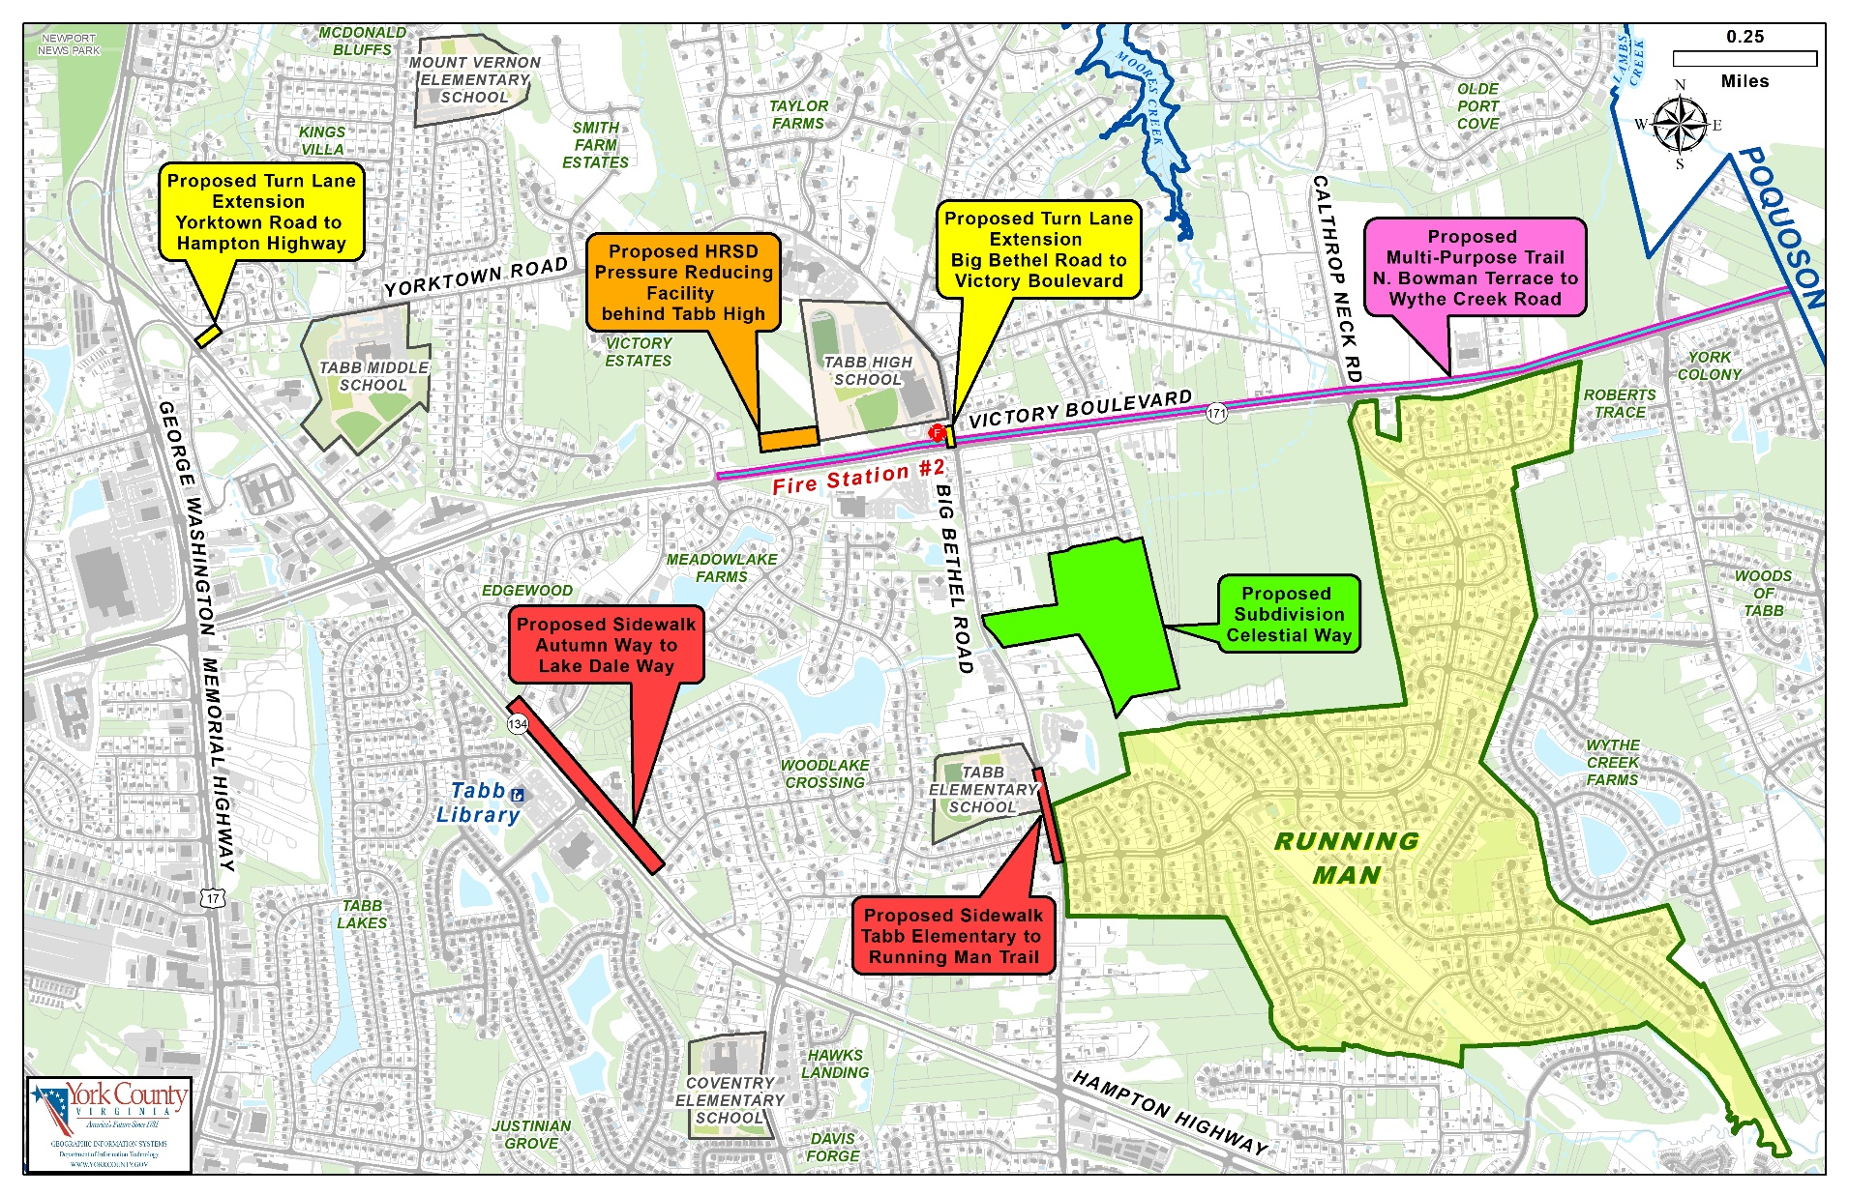
Notes:
Projects Close to Running Man:
Traffic Improvements:
1. Left turn lane on Victory Blvd at N. Bowman Terrace.
2. Right turn lane from Yorktown Road to Hampton Highway.
3. Right turn lane from Big Bethel to Victory Blvd.
4. Intersection improvements at Route 17 and Victory Blvd
Sidewalks:
Hampton Highway: Autumn Way to Lake Dale Way.
Big Bethel Road: Tabb Elementary to Running Man Trail.
Proposed Multi-Use Trail:
Located on Victory Blvd between N. Bowman Terrace and Big Bethel Road.
Trail will eventually travel all the way to Wythe Creek Road in Poquoson.
Proposed Celestial Way Subdivision:
Located off of Big Bethel Road on the east side between Christ the King Episcopal Church and New Bethel Baptist Church.
HRSD Pressure Reducing Facility behind Tabb High School.

Slide 5
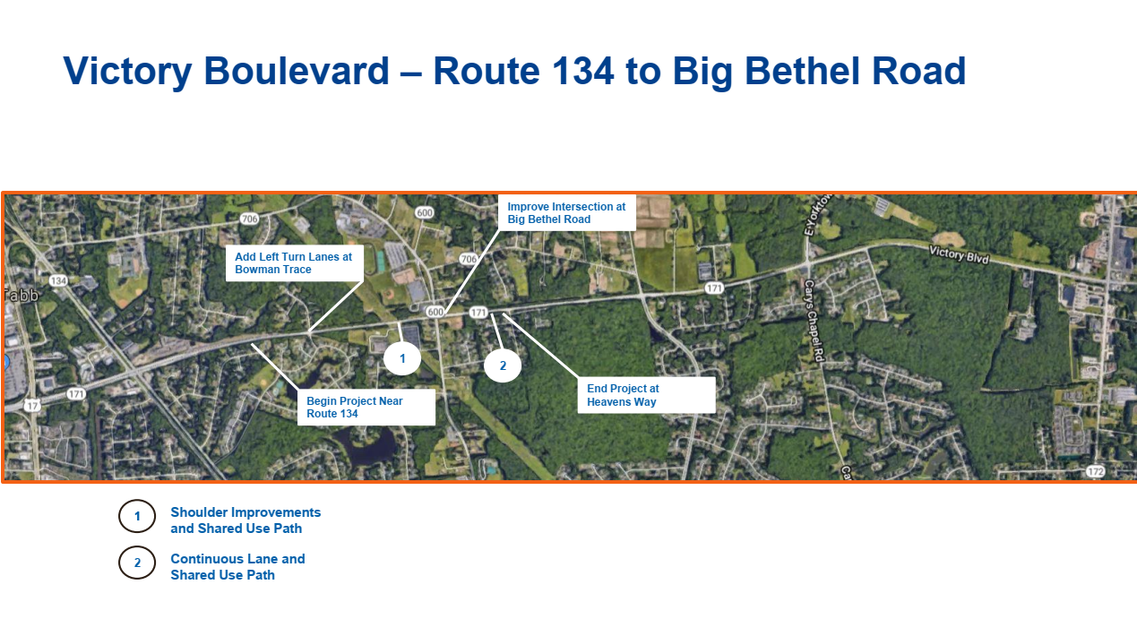
Notes:
4. Intersection improvements at Route 17 and Victory Blvd
Project to improve the intersection of Route 17 and Route 171 by widening northbound and southbound Route 17 approaches and constructing a third left turn lane and a third through lane on the eastbound Route 171 approach.

Slide 6
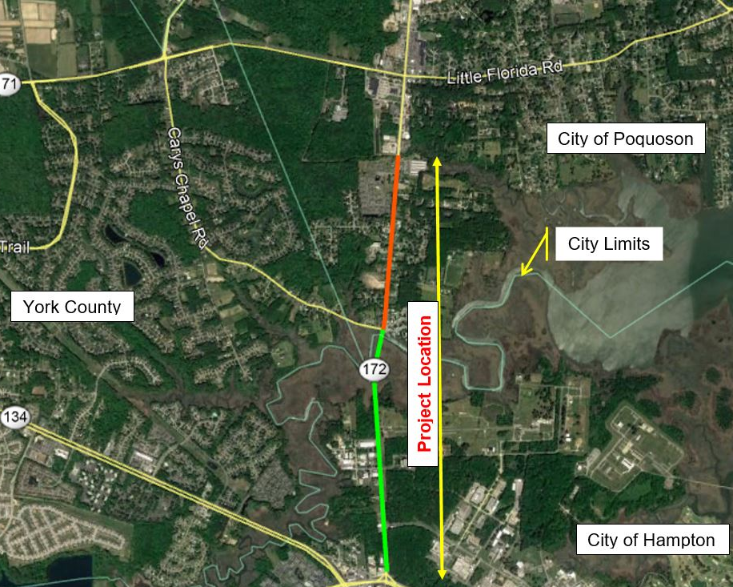
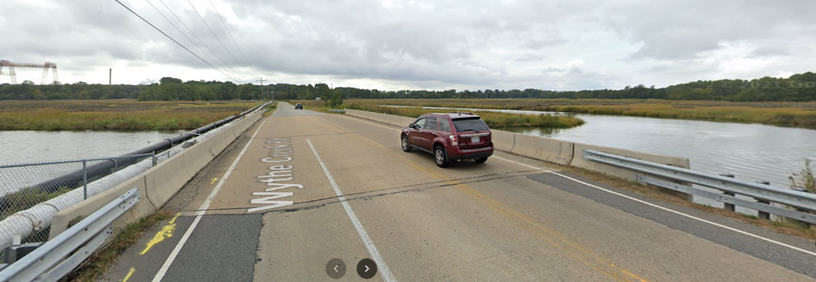
Wythe Creek Bridge Project
Will raise the existing road elevation for emergency evacuation and will widen the roadway to accommodate future traffic volumes.
Current design includes a three lane bridge and a dedicated pedestrian/bike crossing.
Project is currently on hold.
Notes:
Wythe Creek Bridge Project:
Will raise the existing road elevation for emergency evacuation and will widen the roadway to accommodate future traffic volumes.
The project will begin in Hampton and continue through the causeway and into Poquoson. In Hampton, the typical section will consist of a three-lane reversible lane roadway with curb and gutter and an 8-foot sidewalk on the east side through the causeway. In Poquoson, an 8-foot Sidewalk will be constructed on the east side of the road and a 5-foot sidewalk will be constructed on the west side of the road from the Cary’s Chapel intersection to the northern project limit of the project approximately, 2000 feet south of Victory Boulevard. The existing two lanes will be retained north of Cary’s Chapel in Poquoson.
The average daily traffic along Wythe Creek Road is approximately 16,000 vehicles per day.
Design began in January 2013.
Acquisition of right of way is underway.
Value engineering to reduce the scope and cost of the project has occurred twice. The most recent performed by VDOT in July was approximately $25 million over budget.
The project is currently on hold, but the initial estimated completion is fall of 2026.

Slide 7
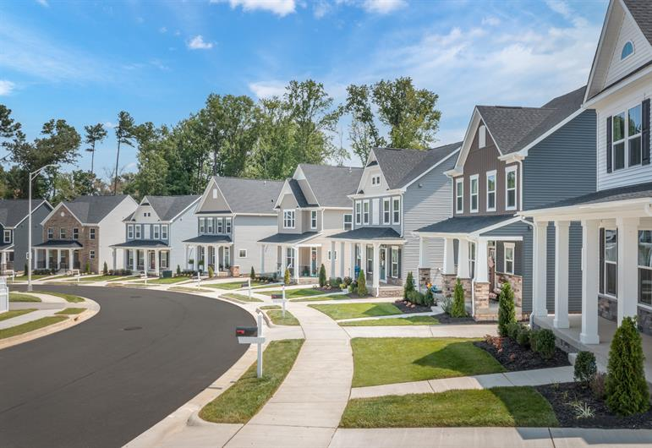
The Legacy of Poquoson
Housing and Retail development off of Victory Blvd.
Project was approved by Poquoson in 2015.
Includes a total of 557 residential units:
  238 single family homes
  108 townhouses
  11 cottage homes
  200 apartments
Notes:
The Legacy of Poquoson:
Housing and Retail development off of Victory Blvd in Poquoson.
Includes a total of 557 residential units and 40,000 sq. ft. of retail space.
Single family homes have been approved and the rest are under review.
The site plan for the commercial areas have not been received.
First units could be occupied in the first quarter of 2023.
Estimated completion is set for 2027; subject to change.

Slide 8
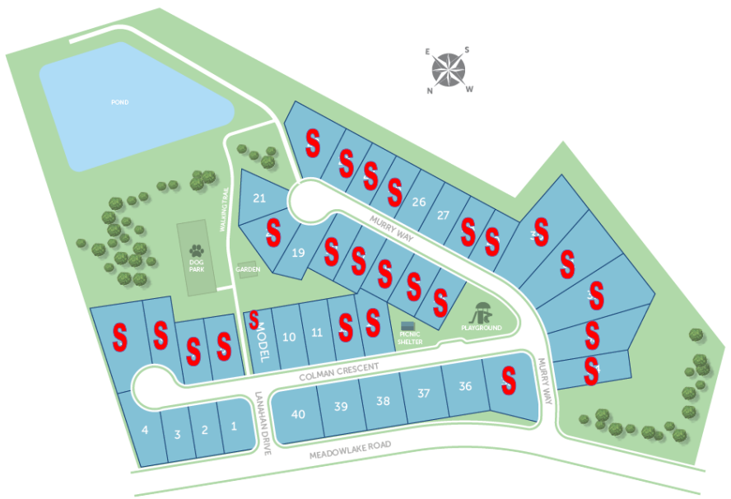
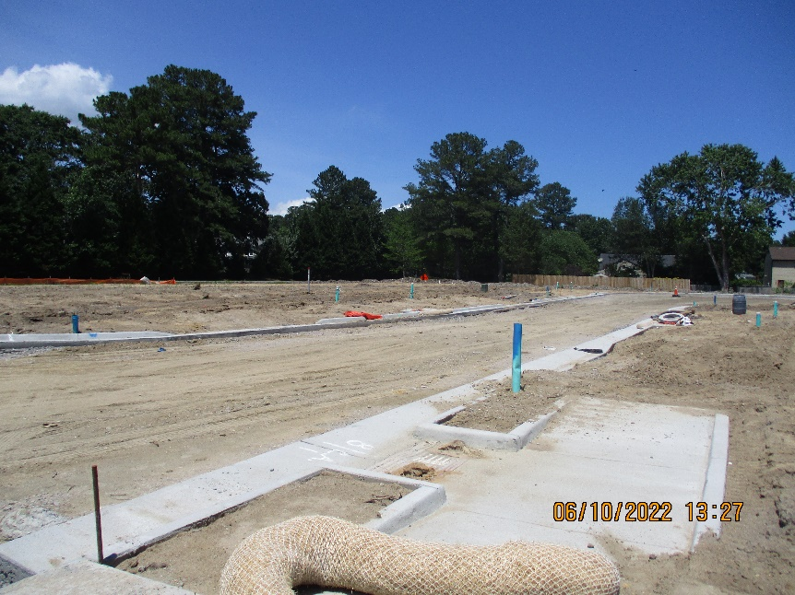
Victory at Tabb Subdivision
Located off of Meadowlake Road.
41-lot single family subdivision utilizing an open space cluster design.
The developer is installing the infrastructure
The first houses will likely be built in the first quarter of 2023.
Notes:
Victory at Tabb Subdivision:
Approved by the County in October 2021.
Located off of Meadowlake Farms.
Currently under construction.
Infrastructure includes: stormwater pond and piping, sanitary sewer, water, streets, etc.
Only show houses have been completed.

Slide 9
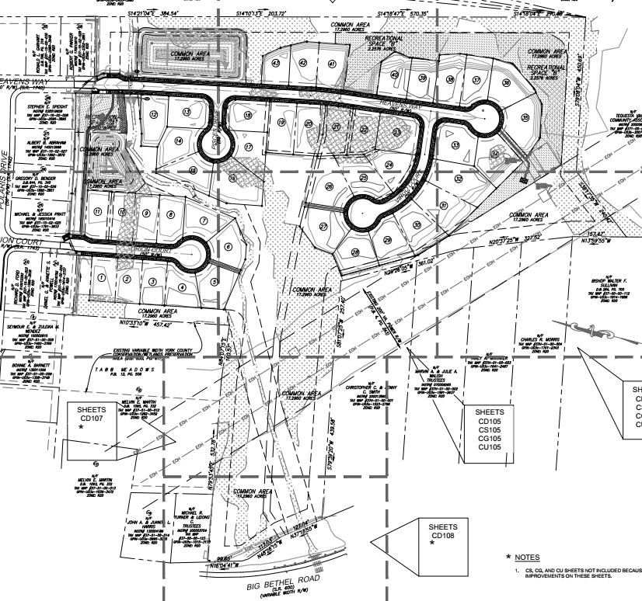
Celestial Way Subdivision
Notes:
Victory at Tabb Subdivision:
Approved by the County in October 2021.
Located off of Meadowlake Farms.
Currently under construction.
Infrastructure includes: stormwater pond and piping, sanitary sewer, water, streets, etc.
Only show houses have been completed.

Slide 10
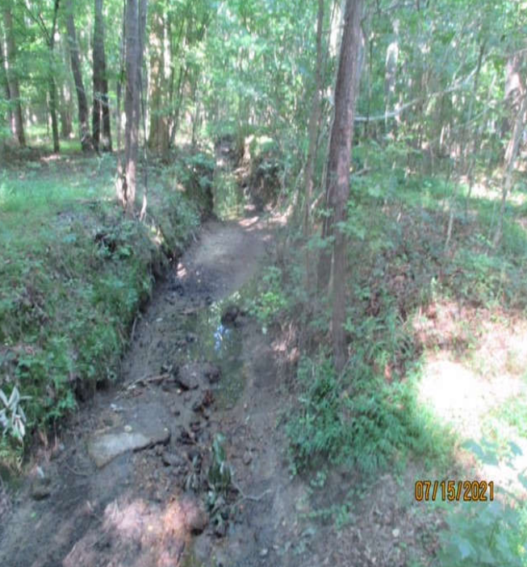
Celestial Way Subdivision
Located on Big Bethel Road.
45 lot single family home subdivision.
Includes a stream restoration project which will result in better drainage and an attractive amenity through the community.
The project will restore over 1,700 linear feet of stream from Big Bethel Road to Heavens Way.
Notes:
Celestial Way Subdivision:
Located at 3960 Big Bethel Road. 45 lot single family home subdivision on 51.31 acres. The developer is Mr. David Lotz. Site plans are currently under review by the County.
The County has partnered with the developer on a stream restoration project which will result in better drainage and an attractive amenity of a stream through the community. The project will restore over 1,700 linear feet of stream from Big Bethel Road to Heavens Way.
The stream restoration is included in the County’s CIP for FY2023 and FY2024, costing $1,250,000. It is the County’s expectation that state grants will cover some of the project’s costs.
Due to the subdivision’s location to wetlands, the developer must work with the U.S. Army Corps of Engineers, obtain an Individual Section 401 Water Quality Certification or waiver from the Virginia Department of Environmental Quality (DEQ), and obtain a permit from the York County Wetlands Board.
No estimated project completion date.

Slide 11
Crime
Telephone scams
  $16,000 scammed
  $97,000 Scammed
Teachers Assaulting Students
  4 teacher arrested in pass six weeks.
Dstrict 5 Crime Watch Report – tgshep@cox.net

Slide 12

FY25 Budget Cycle
2 year real estate assessment cycle.
Increases of 15 to 35%.
Current rate $.77. Lowest full service government in the area.
Capitalizing on last year we also hope to lower the tax rate in the upcoming year.
Home prices still strong.
Notes:
HRSD Tabb Pressure Reducing and Offline Storage Facility:
Will be located behind Tabb High School.
Designed to relieve pressures to the sewer system during wet weather events.
Facility will improve system operations, increase flow capacity, and provide reliable sanitary sewer infrastructure for the community and the region. Will also provide flow balancing for other HRSD treatment plants. System improvements are mandated by the EPA to reduce sanitary sewer overflows.
HRSD held public meetings to explain the project and receive feedback. Original plans included two tanks, but that plan has been reduced to one 2.5 million gallon tank. The tank will be constructed of reinforced concrete and there will be no odor emissions.
Construction is scheduled to begin in fall 2023 and end in spring 2025.
Additional project information, presentations, and HRSD contact information is available at HRSD’s website.

Slide 13
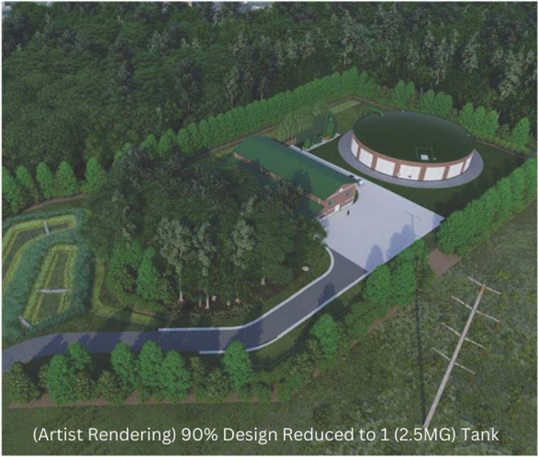
HRSD Tabb Pressure Reducing Pump Station and Offline Storage Facility
Located behind Tabb High School.
Designed to relieve pressures to the sewer system during wet weather events.
Project will consist of one 2.5 million gallon tank.
The tank will be above ground to preserve as many trees as possible.
Fall 2023 – Construction begins.
Spring 2025 – Estimated project completion.
Notes:
HRSD Tabb Pressure Reducing and Offline Storage Facility:
Will be located behind Tabb High School.
Designed to relieve pressures to the sewer system during wet weather events.
Facility will improve system operations, increase flow capacity, and provide reliable sanitary sewer infrastructure for the community and the region. Will also provide flow balancing for other HRSD treatment plants. System improvements are mandated by the EPA to reduce sanitary sewer overflows.
HRSD held public meetings to explain the project and receive feedback. Original plans included two tanks, but that plan has been reduced to one 2.5 million gallon tank. The tank will be constructed of reinforced concrete and there will be no odor emissions.
Construction is scheduled to begin in fall 2023 and end in spring 2025.
Additional project information, presentations, and HRSD contact information is available at HRSD’s website.

Slide 14
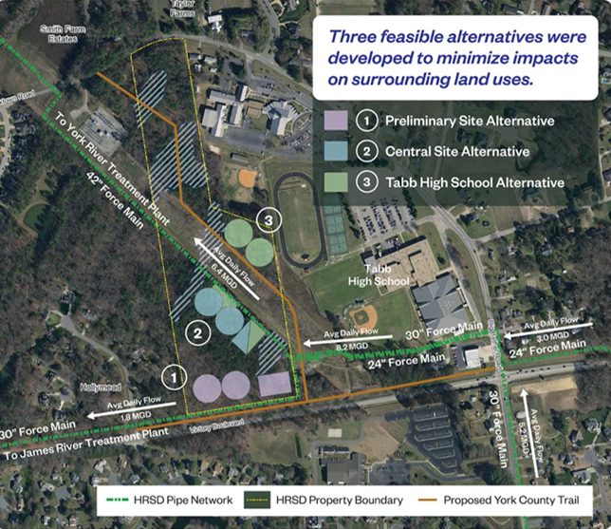
The Central Site Alternative was chosen due to public feedback and project needs
Notes:
The map also includes the proposed multi-use path on Victory Blvd and a proposed York County trail from the multi-use path behind Tabb High to Yorktown Road.

Slide 15
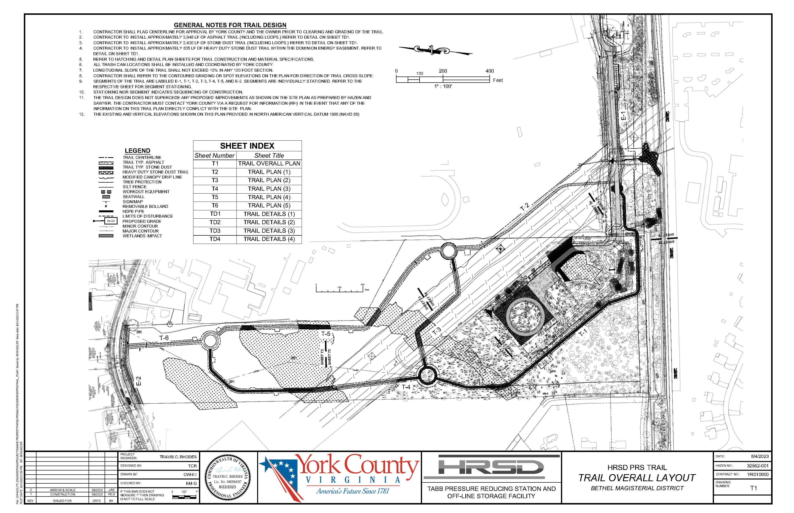

Slide 16
Questions?

Slide 17
PRESIDENT’S REPORT
Eric Todhunter
President

Slide 18
Running Man Community Association
Vision Statement
Have a neighborhood that is engaging, family friendly, and aesthetically pleasing while sustaining a modest annual cost to our neighbors
Strategic Objective
Sustain or improve current community assets and add to the amenities available to the neighborhood as funding permits

Slide 19
Covenants Consolidation
Recap
Initial work began in February 2020 by the Covenant Consolidation Committee consisting of ; Kathy Cook, Kathey Tapfer, Huck Robinson, and Dick Strunk.
  Crafted initial consolidation of covenants into a format provided by RM’s legal advisors
  Passed product off to HOA Board April 2020
Board quickly realized the Covenants and the By-Laws were inter-dependent requiring both to be updated- -effort evolved into an update of all governing documents.
Board took a holistic view of the Running Man governing documents; covenants, By-Laws, and ACC Standards (formerly ACC Guidelines).
Board focused on formatting, organizing the documents, and covering new topics that were not envisioned when the developers began construction of our neighborhood 35 years ago
Board working closely with the legal firm of Gordon, Rees, Scully, and Mansukhani for:
  legal review to ensure everything is still legally sufficient
  Add language to facilitate the RM HOA to annex or acquire assets that facilitates the maintenance of neighborhood property values.
In 2021 the Board began work on update of the Articles of Incorporation as well.
Still waiting on York County Review and approval of draft documents.

Slide 20
Covenants Consolidation
Recap
Features included in the new draft Governing Documents (Covenants, By-Laws, Standard) include:
  Prohibits the use of properties within the neighborhood from being used as a drone distribution center for commerce
  Prohibiting short-term rental thus precluding the establishment of a Bed and Breakfast (AirBnB) establishments within the neighborhood.
  Add language to facilitate the RM HOA to annex or acquire assets that facilitates the maintenance of neighborhood property values.
  The Standards have been reorganized for clarity and will now be reviewed at least annually by the HOA Board for approval.
    Previously the Standards could be changed based on the judgement of the appointed ACC Committee.
    Now recommendation must be made and approved by the elected HOA Board.
    Provides neighbors a means of appeal to the HOA Board if the ACC determines a submitted request does not conform with the approved Standards and denies the submitted request.
    ACC Change Requests will still be required for approval but the submission fee is eliminated.
CY 2023 Goal is to present to the neighborhood the new Covenants, By-Laws, and Articles of Incorporation to the neighborhood for comment and initiate vote for adoption.
CY2024

Slide 21
Covenants Consolidation
Recap
Way-ahead :
  Post proposed Articles of Incorporation, Covenants, and By-Laws to the website to make them accessible for neighborhood to review.
  Board will publish and mail to each home a summary of the new documents highlighting new changes
  Will schedule Question and Answer sessions in the clubhouse for neighbors to personally pose questions to the board. Will attempt to have Notary’s present for neighbors to complete their proxy vote
CY 2023 Goal is to present to the neighborhood the new Covenants, By-Laws, and Articles of Incorporation to the neighborhood for comment and initiate vote for adoption.
CY2024

Slide 22
2023 Long-Range Funding Projection
Take-Away
No dues increase next year
Will monitor - long-term inflation that may adjust this projection
NOTE: (1)Assumes no changes to neighborhood assets or unexpected costs

Slide 23
2024 Long-Range Funding Projection
Take-Away
Dues will increase next year
Will continue monitoring - long-term inflation that may adjust this projection
NOTE: (1)Assumes no changes to neighborhood assets or unexpected costs

Slide 24
Running Man Community Association
Current Situation
Volunteerism within the neighborhood is still waning. Many folks have good ideas or concerns for others to do but few people volunteer to bring their ideas to fruition or concerns to closure.
We can have 9 HOA Board Members. In CY2023 we had 7 board members. Were losing two in 2023 due to conflicting requirements.
Tonight we have 5 board members agreeing to serve another year and only one new volunteer for total of only 6 for the 9 positions.
What does this mean…what is the “so what”
The HOA’s primary responsibility is the protection of the neighborhood and neighborhood property values.
Fewer volunteers means less control over the neighborhoods well being by the residents themselves
Longer reaction times to issues that surface throughout the year.

Slide 25
Running Man Community Association
Volunteer Opportunities
You can still serve the community in other capacities without being on the HOA Board.
Neighborhood Garage Sale Coordinator
Neighborhood Welcome Coordinator
Project Officer supporting a Director Landscape/Common Area Director

Slide 26
ELECTION OF OFFICERS
Current Nominees
Nominations from the Neighborhood – If you’re interested in joining the CY2024 RM HOA Board please let us know.
Vote
Eric Todhunter
Jon Waechter
Kyle Aulenbach
James Wright
Allison Rockwell
David Glover
OPEN - Treasurer
OPEN - Landscaping

Slide 27
COMMUNICATIONS/ WEBMASTER
Allison Rockwell
Director

Slide 28
COMMUNICATIONS/ WEBMASTER
Key Points
The Communications position is responsible for maintaining the Running Man Website and posting Neighborhood Watch alerts. These alerts are posted to the Running Man Nextdoor.com website
The Running Man website, runningmancommunity.com, was designed by RM resident Melissa James of Creative Copy. The website combines the RMCA, RMRA, and swim team information, making it easy to find exactly what you are looking for.

Slide 29

COMMUNICATIONS/ WEBMASTER
WEBSITE: https://www.runningmancommunity.org/
Contact Webmaster: runningmanhoa@gmail.com

Slide 30
TREASURER’S REPORT
GAIL ASTOR
Treasurer

Slide 31
TREASURER’S REPORT
2023 Budget Status
INCOME | 2023 BUDGET | JAN - NOV | % OF BUDGET
Architectural Fees | $ 500.00 | $ 825.00 | 165%
Disclosure (Home Owner) Packets | 3000.00 | $ 1,900.00 | 63%
Dues ($210 x 589) (588/589) | 123,690.00 | $ 123,480.00 | 100%
DISH Network | 8,400.00 | $ 0.00 | 0%
Tax Refund (State of VA) |  | $ 167.00
Verizon Tower | 10,117.00 | $ 9,323.65 | 92%
TOTAL INCOME | $ 145,707.00 | $ 135,695.65 | 93%
Page 1 of 3

Slide 32
TREASURER’S REPORT
2023 Budget Status
EXPENSE | 2023 Budget | Jan – Nov | % Budget
Administration - Stipend | $ 1,800.00 | $ 1,650.00 | 92%
Annual Meeting | 750.00 | $ | 0%
Annual State Registration | 155.00 | $ 155.00 | 100%
Board - Treasurer, Supplies, etc. | 350.00 | $ 338.86 | 97%
Disclosure Packet - Costs | 300.00 | $ 208.22 | 69%
- Stipend | 1,200.00 | $ 760.00 | 63%
Dues Letters - Costs | 750.00 | $ 47.25 | 6%
- Stipend | 883.50 |  | 0%
Electricity | 3,600.00 | $ 2,646.67 | 74%
Garage Sale | 400.00 | $ 329.29 | 82%
Grounds Improvements (New/ Repairs) | 4,500.00 | $ 3,635.00 | 81%
Grounds Maintenance | 60,000.00 | $ 54,885.38 | 91%
Insurance - Common Area | 5,400.00 | $ 7,342.00 | 136%
Legal Fees | 10,000.00 | $ 13,975.79 | 140%
Luminaries | 3,200.00 |  | 0%
Page 2 of 3

Slide 33
TREASURER’S REPORT
2023 Budget Status
EXPENSES | 2023 BUDGET | JAN-NOV | % BUDGET
Neighborhood Watch | 7,271.50 |  | 0%
Pond Maintenance | 4,450.00 | $ 4,051.08 | 91%
Post Office Box Rental | 166.00 | $ 166.00 | 100%
Storage Unit | 1,535.00 | $ 1,574.00 | 103%
Taxes – Accountant Fees | 850.00 | $ 850.00 | 100%
- Federal (Paid) | 3,000.00 | $ 2,863.00 | 95%
- State (Paid) | 800.00 | $ 600.00 | 75%
- York Co. RE (Verizon Tower) | 300.00 | $ 0.00 | 0%
Welcome Packets | 150.00 |  | 0%
Youth Activities:
After Prom | 200.00 | $ 200.00 | 100%
Cookies with Santa | 150.00 |  | 0%
Easter Egg Hunt | 275.00 |  | 0%
Halloween Parade | 500.00 | $ 327.38 | 65%
Octoberfest |  | $ 639.80 | 0%
Safety Town | 200.00 | $ 200.00 | 100%
Swim Team | 500.00 | $ 500.00 | 100%
Capital Improvemnts (Res.Fund Contrb.) | 32,071.00 |  | 0%
TOTAL EXPENSE | $ 145,707.00 | $ 97,944.72 | 67%
ASSETS
CHECKING: $24,040.97
SAVINGS: $ 25.00
M.M.&CD: $196,020.26
$220,086.23
Page 3 of 3

Slide 34
TREASURER’S REPORT
2024 Budget
2024 BUDGET
INCOME
Architectural Fees $750.00
Disclosure Packets $2,000.00
Dues (589X$220.00) $129,580.00
Verizon Tower $10,950.00
TOTAL INCOME $143,280.00
Page 1 of 2

Slide 35
TREASURER’S REPORT
2024 Budget
EXPENSES
2024 BUDGET
EXPENSES
2024 BUDGET
EXPENSES
2024 BUDGET
Admin- Stipend $ 1,800.00 Annual Meeting $750.00
Annual State Registration $155.00
Board Treasurer Supplies $350.00
Disclosure Pkg Costs $300.00
Stipend $800.00
Dues Letters- Cost $750.00
Stipend $883.50
Electricity $3,900.00
Garage Sale $400.00
Grounds Improvements $3,790.50
Grounds Maintenance $60,925.00
Insurance-Common Area $7,500.00
Legal Fees $11,500.00
Luminaries $3,200.00
Neighborhood Activities $2,750.00
Neighborhood Watch $ 300.00
Pond Maintenance $4,610.00
PO Box Rental $ 166.00
Reserve Fund Update $2,000.00
Storage Unit $1,800.00
Taxes-Accountant Fees $ 850.00
-Federal $3,600.00
-State $ 800.00
Welcome Packets $ 100.00
Reserve Fund Contrib. $29,300.00
TOTAL EXPENSES $143,280.00
Page 2 of 2

Slide 36
TREASURER’S REPORT
2024 Annual Dues Letter
This letter is to inform you that the annual Running Man Community Association, Inc. (RMCA) assessment will increase for the 2024 calendar year to $ 220.00 per lot owned which reflects an increase of 5% in accordance with our Covenants and Bylaws. Annual assessment payments are due January 1st each year. Any assessment payment which is not paid within 30 days will be delinquent.
Your 2024 annual assessment payment should be submitted as follows:
Payment is due and payable by January 1, 2024, and will be considered delinquent if not received by January 31, 2024.
Make checks payable to RMCA in the amount of $ 220.00
Mail to: Running Man Community Association
P.O. Box 2114
Poquoson, VA 23662
Please Include your Running Man street address on the check to ensure proper credit to your account
All Payments: via online banking, personal check, cashier’s check, or money order must be postmarked by January 31, 2024 and be submitted for the 2024 annual assessment amount of $220.00 to be considered on time.
Failure to pay your assessment in full by the deadline may result in your account being turned over to our attorney for collections. The initial charge for the demand letter from our attorney will be $ 192.00, which amount will be added to your account. Such amounts are your responsibility under the governing documents of the Association. Legal fees and costs shall continue to accrue as additional collections efforts are taken until such amount is paid in full.
To avoid additional charges and / or collections actions, including, but not limited to, the filing of a memorandum of lien against your lot, please make your payment on time.
Note: The RMCA will not send multiple reminder letters.
Thank you in advance for your assistance.
RMCA Board

Slide 37
James Wright
Neighborhood Watch

Slide 38

NEIGHBORHOOD WATCH
Flock Safety Sparrow Automatic License Plate Recognition (ALPR) Camera
Self contained - Can be installed anywhere
Company maintains and services the camera for an annual subscription price of $2,400/unit per year (plus a one-time installation cost of $350 per camera).
Provides vehicle “Fingerprint” technology. Footage provides ability to provide:
  Timestamp
  Vehicle Make and Color
  License plate
  Number of visits
Software compatible with software installed in York County patrol cars.
Recommended by incoming York County Sherriff MAJ Montgomery
Potential Sites
RM Trail x4
Messongo X1
Pohick X1
Tuckahoe X1
Est. One-time Installation: $2450 Est. On-going annual expenses: $16,800

Slide 39
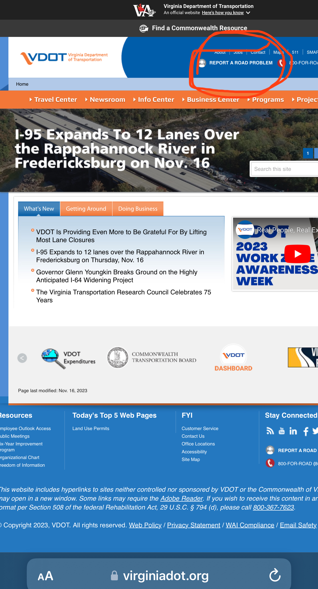
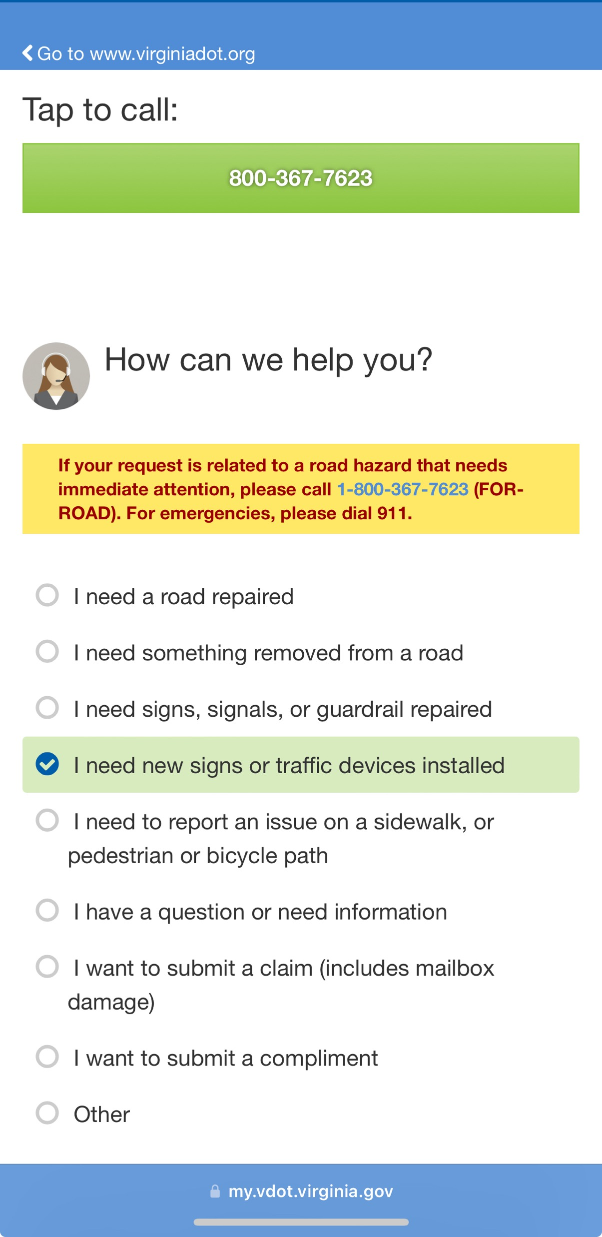

How to Report Road/Sign Issues?
NEIGHBORHOOD WATCH

Slide 40
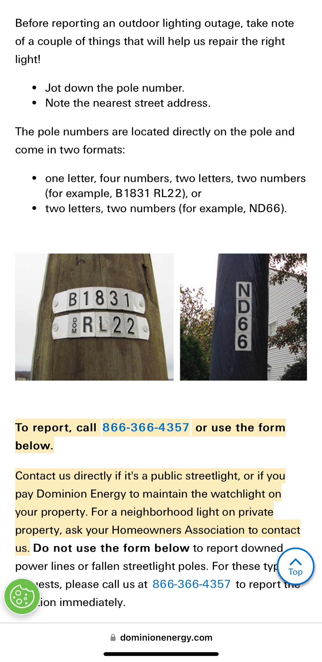
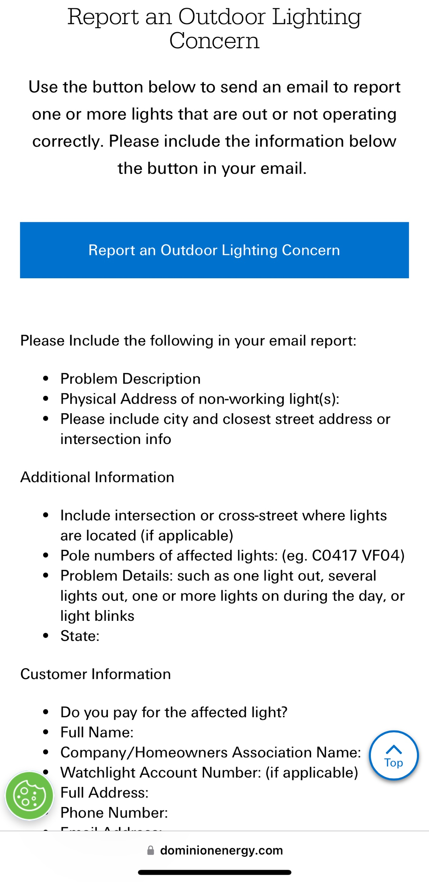

Need to report a streetlight outage?
NEIGHBORHOOD WATCH

Slide 41
ARCHITECTURE CONTROL COMMITTEE
Jon Waechter
Director
*Need a replacement*

Slide 42
Committee Members
ARCHITECTURE CONTROL
Kyle Aulenbach
James Wright
Melissa Shandor
Breana Schaefer

Slide 43

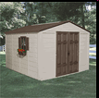

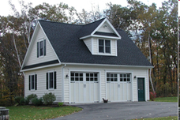
Running Man ACC
ARCHITECTURE CONTROL
Architecture Control Committee (ACC) focuses on additions or external modifications to the property
Contact the ACC Chair if you have questions about your project before you begin your project.

Slide 44
ACC Submissions
ARCHITECTURE CONTROL
The ACC Change Request form can be obtained on the RMCA website, then the HOA link.
Email, call, or text the ACC Director for submission process for quickest response.
Please include pictures that show the location of the addition, your plat, as well as a detailed description of the project, and check for the $25 fee made payable to RMCA.

Slide 45
ACC Notes of Interest
ARCHITECTURE CONTROL
33 Inquiries / Requests processed in 2023, down from 45 in 2022
19 Disclosure Packets
In late 2023, we published new ACC Standards to provide clarification on new projects, repair vs. replacement, and maintenance of existing structures. The standards appeared to help clarify responsibilities and will be updated as needed.
The location of your property may be in a Resource Protection Area (RPA) or a Resource Management Area (RMA) and may slightly vary the ACC Standards, which is why it is important to check with the ACC before any work begins on your project for approval.

Slide 46
Running Man Standards
ARCHITECTURE CONTROL
Not necessarily specific to Architectural items
Defines
  Repair – replacing existing with same color, material, and size – ACC approval not required
  Replace – same feature, however, new material or color – ACC approval is required
  New – a permanent fixed structure not existing before – ACC approval is required
Offers specifics to help homeowners draft plans for certain elements
Maintenance reminder for certain expectations that do not require ACC approval – free of mold, roofs and gutters free of debris, etc.

Slide 47
COVENANTS
Kyle Aulenbach
Director

Slide 48
COVENANTS
Covenants’ purpose
  Maintain property values and minimize annoyance, distraction or offensive property use
Board’s current covenants philosophy
  Pragmatic enforcement of clear-cut covenants violations mixed with polite engagement on less-clear issues
What I *DON’T* do
  Drive around specifically looking for violations
  Walk onto your property to inspect something
What I *DO* do
  Respond to complaints I’ve received from Running Man residents (~10 this year)
  Most common infractions: Signs, trailers, boats and RVs in driveways
  Engage residents on issues I happen to notice while traversing the neighborhood

Slide 49
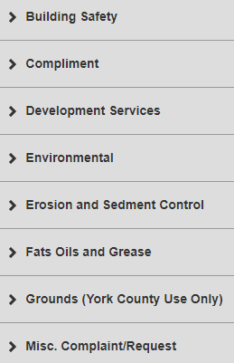
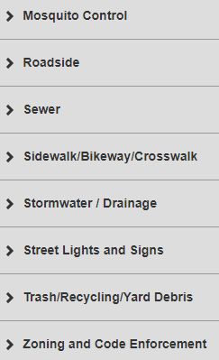
COVENANTS
York County Customer Service Requests
https://yorkips.yorkcounty.cloud/
See list
York-Poquoson Sheriff’s Non-Emergency No. 757-890-3621

Slide 50
LANDSCAPE/COMMON AREAS
Chris Lowery
Director

Slide 51
Duties of the Landscape Director
Attend Board of Directors monthly meetings
Monitor contractors
Routinely Inspect landscaping through-out Running Man Neighborhood
Recommend improvements
Oversee new plantings, signs, entrance lighting and brick walls
Provide assistance to the board and members
Operate within the budget

Slide 52
2023 Year-End Review
Oversaw maintenance of bushes, trees and plants in common area
Oversaw installation of bushes, mulch, and plants (perennials and annuals)
Worked with Grasswackers Inc. weekly during the summer to insure contractor performance
Removed multiple large branches damaged in storms

Slide 53
2023 Year-End Review
Assisted in the establishment of Monarch Motel
Removed & replaced 3 dead Crepe Myrtles with 3 - 7 ½ foot Crepe Myrtles along Running Man Trail (RMT)
Removed 3 dead bushes at the entrance of RMT and Big Bethel and transplanted 2 bushes to replace
Filled sink hole adjacent to RMT and pond

Slide 54
SUMMARY
Eric Todhunter
President

Slide 55
Running Man HOA Board 2023 Summary of Actions Overview
On-going actions with York County Attorney to finalize new proposed neighborhood governing documents
Completed another maintenance washing of serpentine wall and monuments
Co-sponsored with RMRA a new “Octoberfest” event
Researching options to repair or replace Running Man signage on entry monuments
Reviewed Neighborhood’s Long-Range Financial Posture (Nov 2023)
Replaced pond fountain

Slide 56
Running Man HOA Board 2024 Goals
Complete socialization and begin voting on new proposed neighborhood governing documents
Contract for the conduct a new Reserve Study to capture inflation (last conducted in 2018)
Complete work on Running Man signage for entry monuments

Slide 57
Christmas Luminaries
Need Volunteers to:
  Pack and Deliver at the Clubhouse Dec 17th
  Put candles out in Common Areas Dec 24th
  Pick up candles from Common Areas Dec 25th.
Sand Delivery ~Mon, Dec 18th
Luminaries Inclement weather decision will be posted on the Next Door Neighbor App and Running Man website.
If you’re not going to be home, need help, or are able to volunteer please notify Jen Arnold via text or call @ (719)339-0907.

Slide 58
ELECTION OF OFFICERS
Current Nominees
Nominations from the Neighborhood to serve on the CY2024 RM HOA Board.
Vote
Eric Todhunter
Jon Waechter
Kyle Aulenbach
James Wright
Allison Rockwell
David Glover
OPEN – Matthew Matson
OPEN – Russ Kratoville

Slide 59
Thanks for Your Support
and
Happy Holidays
from the
Running Man Community Association Board

